Slide 1


cortexa7 review
Peng Chen
2017.11.07

Slide 2
Contents
Design diagram
Feature list
Low power design
Software
SIM
Synthesis and DCG flow

Slide 3
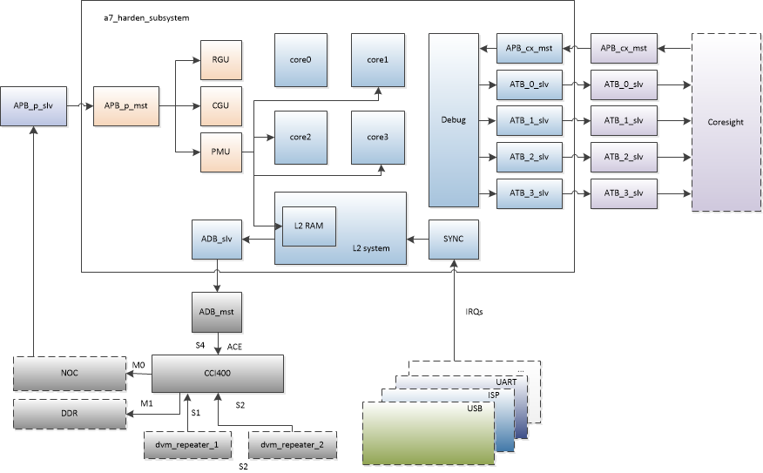
Design Diagram

Slide 4
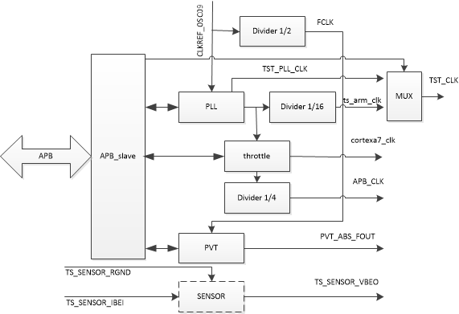

Design Diagram ---- CGU
throttle function

Slide 5
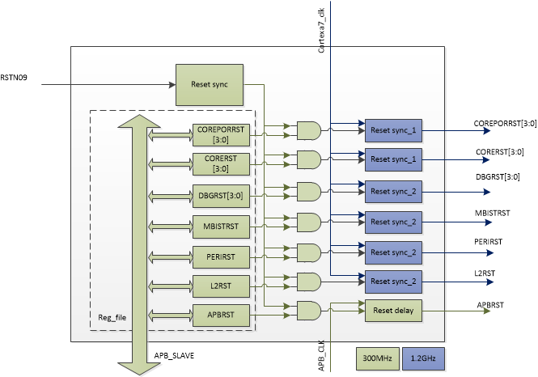
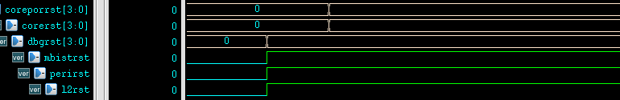
Design Diagram ---RGU
Reset sequence

Slide 6
Feature list
4 cores in the cortexa7 MPCore.
192 SPI interrupts in which there are 160 external device interrupt.
32KB L1 I Cache, 32KB L1 D Cache.
512KB L2 Cache.
FPU VFPv4-D16.
NEON provide support for the ARMv7 Advanced SIMDv2 and Vector Floaint-Pointv4 instruction sets.

Slide 7
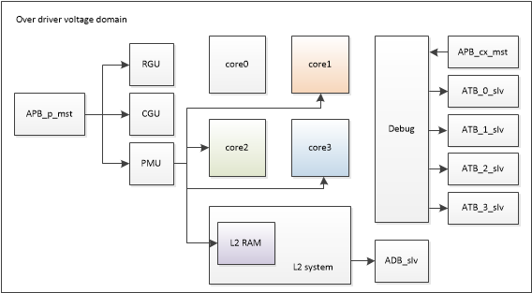
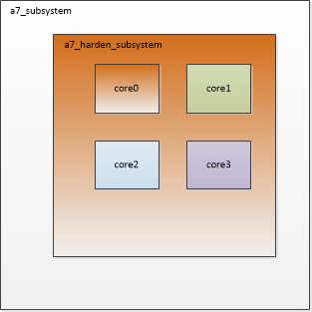
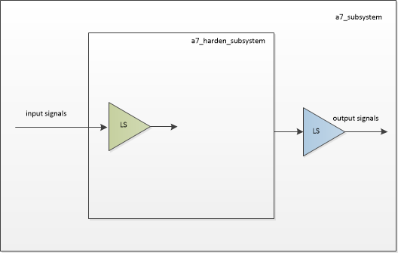
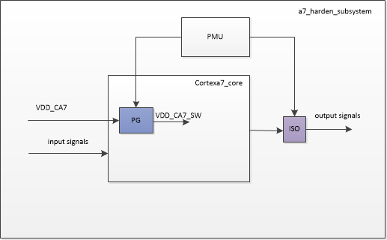
Low power design
shutdown
Power domain
input LS
power gating
output LS
isolation cell
mem with PG

Slide 8
Power down sequence
WFI
ISO CLAP
POWER DOWN

Slide 9
Power on sequence
RST assert
Power on
ISO release
RST release

Slide 10

Software
code @rom
data @ram
stack @ram
cortexa7
cortexa7_boot
cortexa7_sram
cortexa7_boot_bb
cortexa7_sram_bb
code @rom
First level boot
cooperate with cortexa7_sram
code @BB_SRAM
data and stack @MAIN_SRAM
code @rom
First level boot
cooperate with cortexa7_sram_bb
code @MAIN_SRAM
data and stack @MAIN_SRAM

Slide 11
RTL SIM ----- cortexa7
scompile a7_test –docompile
a7_test/main_a7.c → cortexa7/main.c
make
convert bin to hex file code.hex.
RTL compile and sim(read in the code.hex)
3 cores get into sleep mode
data section initialization @sram
stack initialization @sram
Jump to main function(your code).

Slide 12
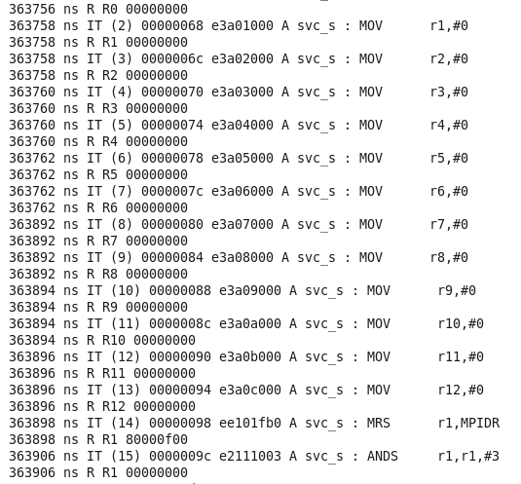
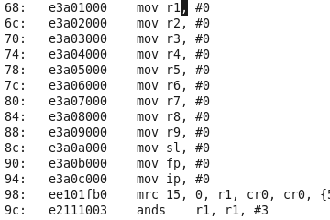
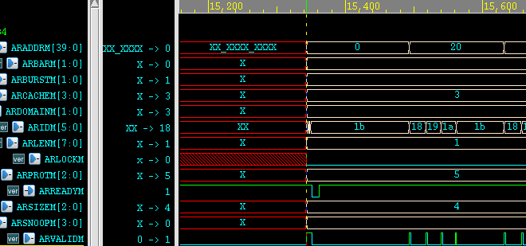
RTL---SIM debug
Time
Address
disassemble
code
assembly
Result
Waveform
Verdi HWSW is like codelink

Slide 13
POST SIM ---- cortexa7_sram
Need to define POST_SIM
scompile a7_test –docompile
a7_test/main_a7.c→ cortexa7_sram/main.c
make(cortexa7_boot and cortexa7_sram)
bin2hex: boot.hex, code_l.hex and code_h.hex
RTL compile and sim(read in boot.hex, code_l.hex and code_h.hex)
BOOT ROM
BB_SRAM

Slide 14
Local sim environment
simulation location /home/pchen/A7/Cortex-A7-r0p5-00rel0/cortexa7/logical/cortexa7_intkit/validation @eda-11
Doc location
/home/pchen/A7/Cortex-A7-r0p5- 00rel0/cortexa7/logical/cortexa7_intkit/validation @eda-11

Slide 15
local sim --- test case
Configuration tests: Verify the configuration of the system.
Integration tests: Verify the connection of all the components.
Functional tests: Demonstrate and test the correct basic functionality of configurable components of the system
Power tests: Indicate the power characteristics.
mmu, L1 cache and L2 cache; FPU and NEON;

Slide 16
local sim run
source dotcshrc
modify ikvalidate.cfg
source configure_rtl_kit.pl
source_me.modelsim
ikvalidate
sim process

Slide 17
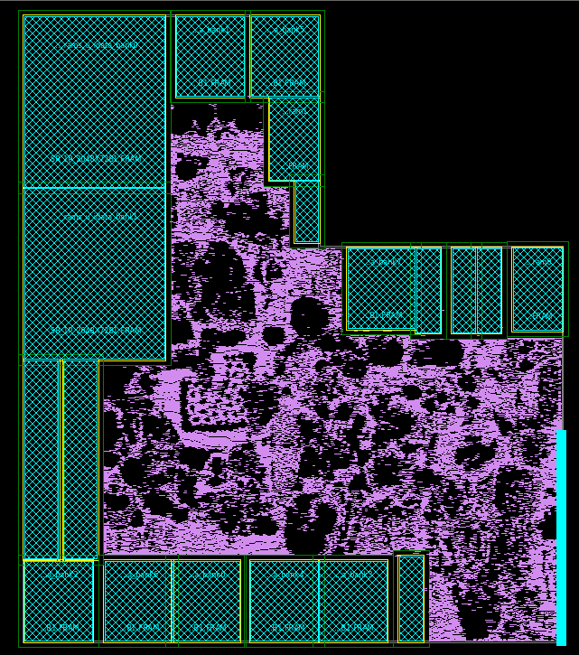
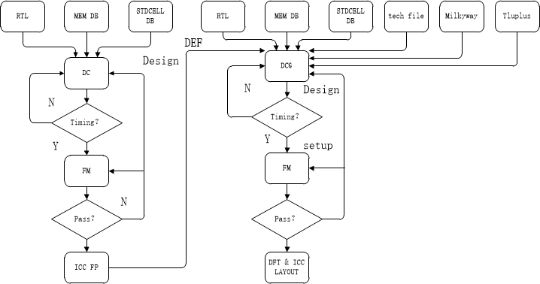
DCG flow
Floor Plan of cortexa7core

Slide 18
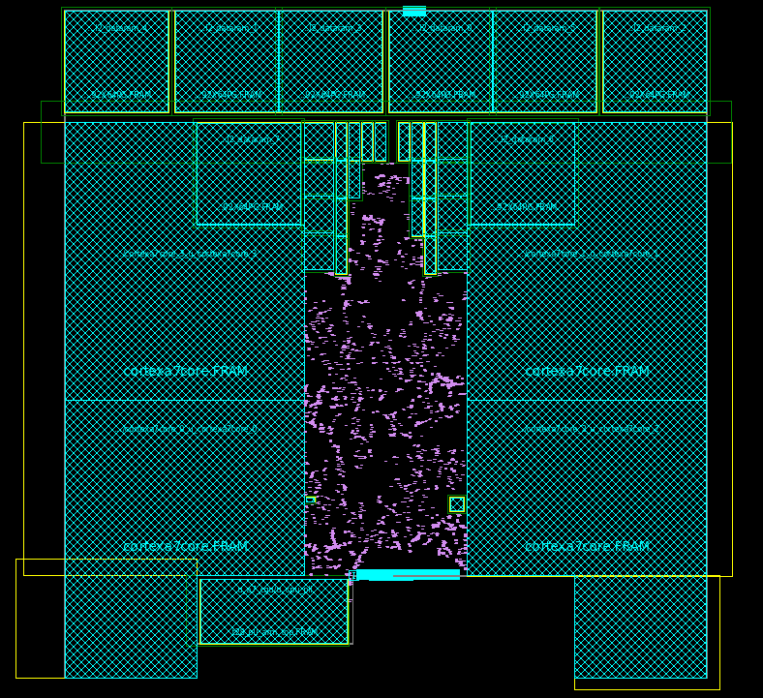
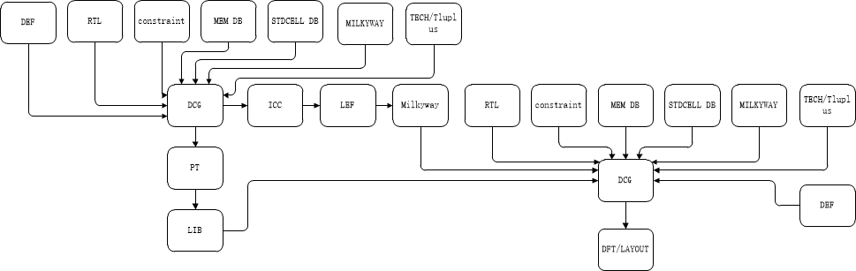
Bottom up DCG
a7 core
a7 harden

Slide 19
DCG flow
congestion
Advance：
Accurately predict post-layout timing, area and power during RTL synthesis without the need for timing approximations based on wire load models.
Goal
Provide a better optimized starting point for physical implementation.

Slide 20
Q&A
Thanks

